Slide 1

SECRET CYBER INVESTIGATION AGENCY
VERSION 1.1
By:
Naga Malleswara Rao (10bce0114)
Saurav Majumder (10bce0274)
Saketh P (10bce0495)

Slide 2
Problem Description
Too much risk of online theft and phishing in 3 main areas in this particular domain-
* Credit card details
* Username/Password
* SN sites/E-commerce domain(cheating)
By this people’s privacy is disturbed highly and they cannot live peacefully after
that, so this project aims to eradicate such defaulters and put justice back where it belongs (TO THE RIGHFUL USERS).
Implement a secret cyber investigation agency where trackers are recruited by the agency.
Trackers are assigned cases based on their order of precedence.
The trackers need to make sure that they provide a cyber crime free environment.
The hackers and phishers need to be prevented from misusing credit card details and personal user accounts

Slide 3
AIM
Develop a scene software for a secret cyber agency
Control phishing activities and prevent username/password theft
Monitor activities of suspicious users online
OBJECTIVE
To ensure a communication channel between participating entities
Interactive system to ensure secure communication between Tracking agency and trackers
SCOPE
With technology on the up rise to ensure cyber crime free environment in the jurisdiction of the online server
Immense help to the government to minimize cyber frauds
Can help users enjoy a threat free surfing experience
Online shopping forums and social networking sites get a boost

Slide 4
PROCESS MODEL IDENTIFICATION
The desired project has the following functionality:
High reliability
Thorough risk analysis and management plan
Fast upload of data
No constraint on resources (memory, cost and power) in development of software
Active participation of the intelligence agency in the design, development and maintenance of the software.
Hence we chose an INCREMENTAL SDLC model

Slide 5
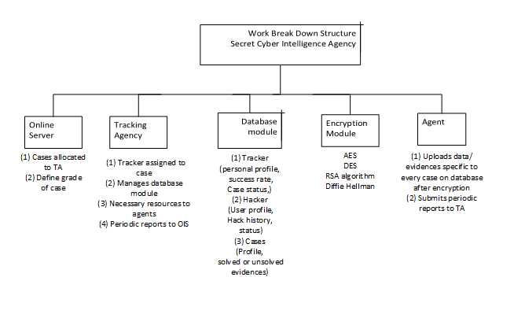
WORK BREAKDOWN STRUCTURE

Slide 6
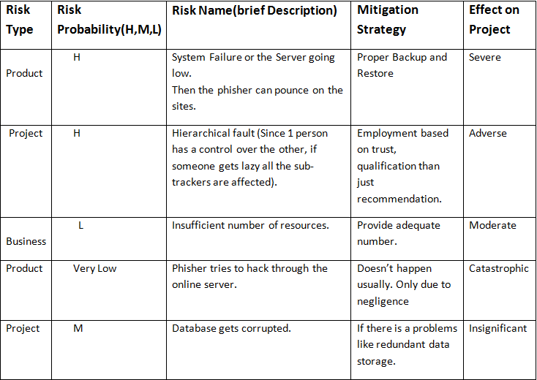
RISK MANAGEMENT

Slide 7
TRACEABILITY MATRIX-
Brings out the X-Y relationships in 3 forms-[Requirement(r),Design(D) and Source(s)]
Participating Entities | Online Server | Tracking Agency | Tracker | Hacker | User
Online Server |  | R | R
Tracking Agency | R |  | S | D | D
Tracker |  | R |  | D | R
Hacker |  |  |  |  | D
User | R |  | S

Slide 8
FUNCTIONAL REQUIREMENTS
Online Server
Receive case
Define grade of case
Assign case to TA
Tracking Agency
Assign case to appropriate tracker
Provide resources to trackers
Submit report to OlS
Maintain database
Tracker
Investigate cases
Upload evidences
Report to TA

Slide 9
NON FUNCTIONAL REQUIREMENTS
Usability
Performance
Capacity
Recovery
Availability
Reliability
Maintainability
Portability
Privacy

Slide 10
CONSTRAINTS
Cases are investigated in order of precedence of grades of each case
Trackers should not fall out of the module assigned to them
Online server updates firewalls of sites based on issue of permission
Maintenance of database to avoid stagnation of data
Not more than two cases assigned to a particular tracker

Slide 11
DOMAIN REQUIREMENTS
Exactness- Assists only users in the online shopping forums, people having bank accounts and social networking site users
Implicitness- Supervisors need to ensure that recruits are skilled enough to handle cases assigned to them
Understandability - Requirements are expressed in the language of the application domain,so may not be always clear to software engineers but are understood by the people who are involved in real time agencies.

Slide 12
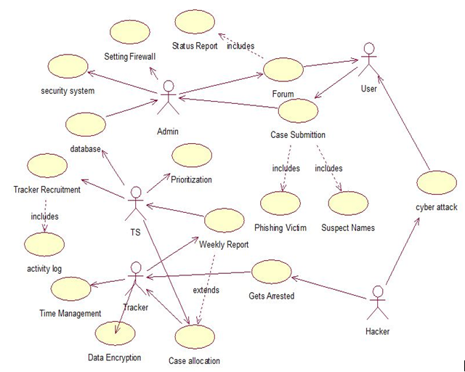
USE CASE DIAGRAM

Slide 13
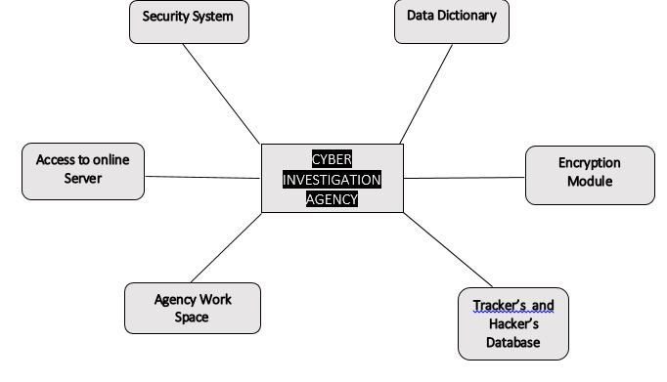
ARCHITECTURAL VIEW
System Structuring: CLIENT-SERVER
model
Control Model : A Call Return
model
Modular Decomposition :
Combination of both top down and the bottom up approach. For clear requirement gathering.
An object oriented approach is followed.

Slide 14

THANK YOU

